Slide 1

Place
here your
photo
Your Name / Family Name
Your Company/Institution

Slide 2
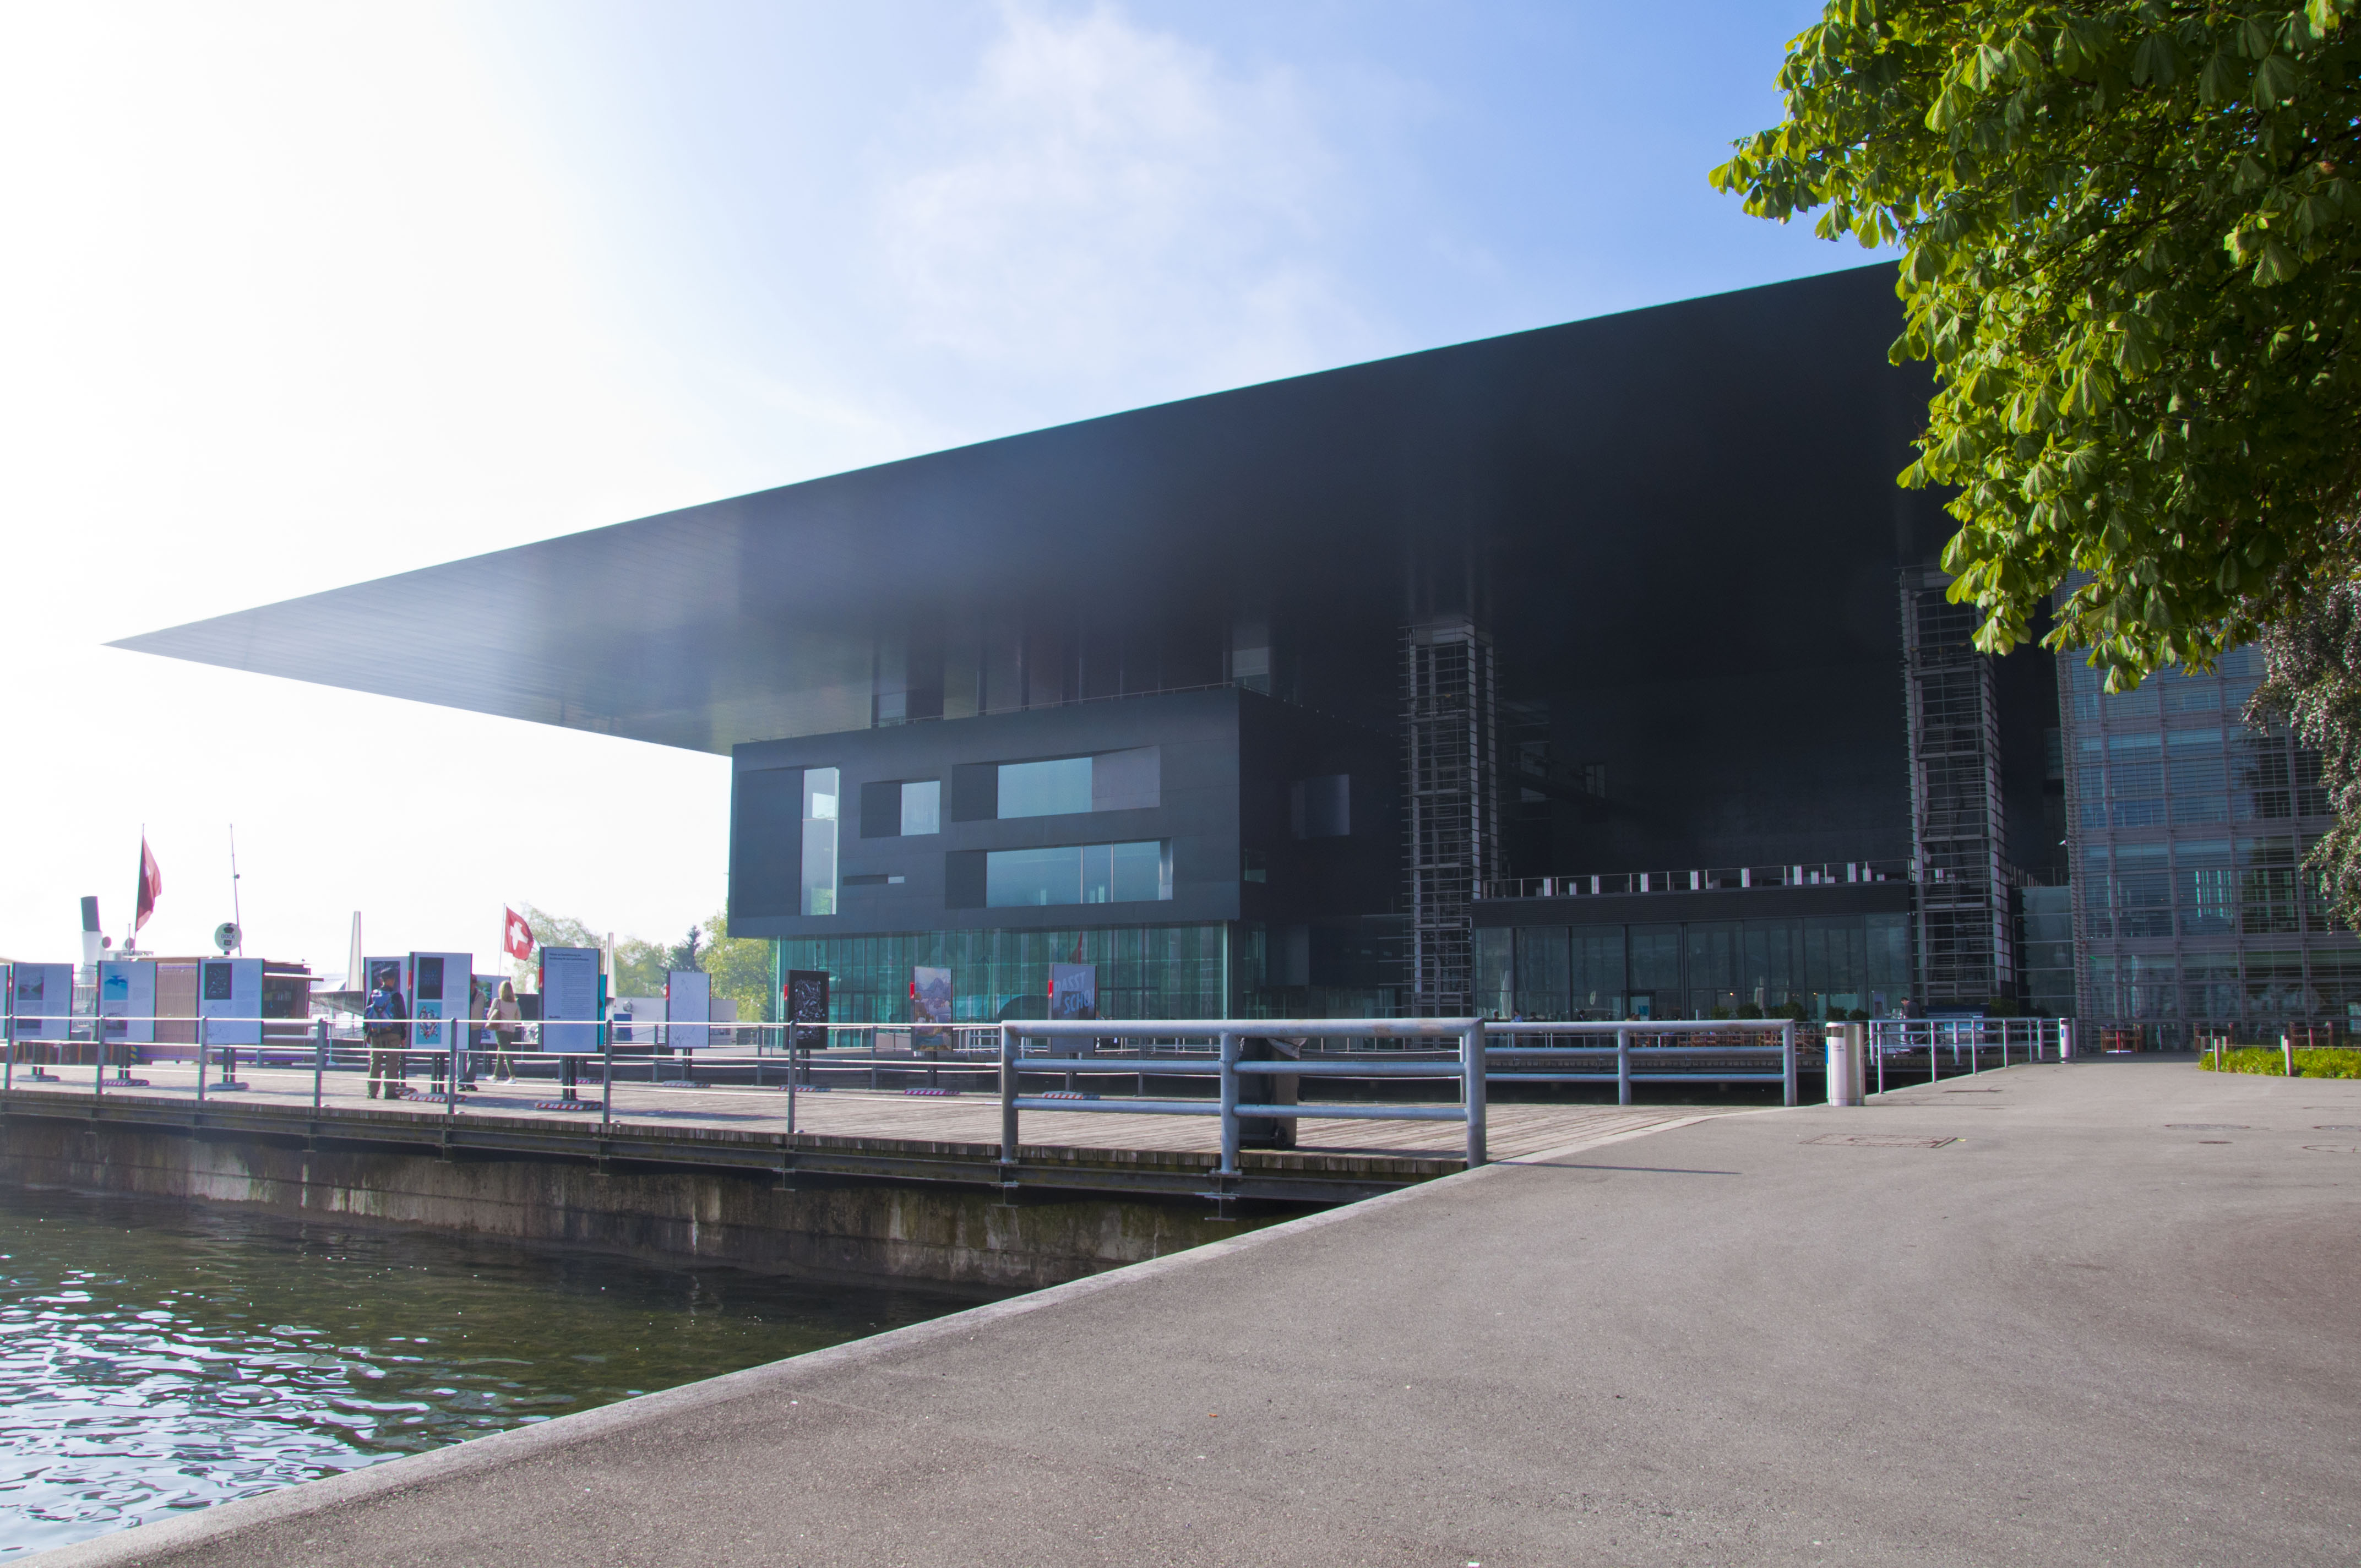

Europe’s leading platform
for Fuel Cell, Electrolyser and Hydrogen Technologies
Join me
Low-Temperature
Fuel Cells, Electrolysers & H₂-Processing
29 June – 2 July 2027 in Luzern/Switzerland
www.EFCF.com
Session Chair

Slide 3
Text proposals
Find below some ready-to-use text samples for your LinkedIn posts that can be combined with the provided and customisable images. Please tag the EFCF so we can like/share the post.
_________________________
(1)
Excited to be part of the @EFCF - European Electrolyser and Fuel Cell Forum, Europe's leading platform for Fuel Cell, Electrolyser and Hydrogen Technologies, which will take place on 29 June – 2 July 2027 at the KKL Luzern in Lucerne/Switzerland.
To join me, click here: www.EFCF.com
Don’t miss the incredible opportunity to meet top experts from industry, research, and policy, discover cutting-edge innovations, and explore real-world applications that are shaping the future of clean energy. Let's get started! 🚀
#EFCF2027 #exhibition #electrolyser #fuelcell #hydrogen

Slide 4
(2)
Thrilled to present at @EFCF - European Electrolyser and Fuel Cell Forum, Europe's leading platform for Fuel Cell, Electrolyser and Hydrogen Technologies, which will take place on 29 June – 2 July 2027 at the KKL Luzern in Lucerne/Switzerland.
To join me, click here: www.EFCF.com
The event provides many opportunities for informal exchanges between industry, market and academia, a platform for technology transfer and recruitment of qualified students and trainees. Let's get started! 🚀
#EFCF2027 #exhibition #electrolyser #fuelcell #hydrogen

